Slide 1
COMPANY PRESENTATION
DEUFOL

Slide 2
Removing Limits The solution to recurring supply chain challenges...
What does the content look like?
Has the supplier already supplied data?
Container? Ready for despatch?
Did the goods arrive "in one piece"?
What are the dimensions and weights?
How is the construction site co-ordinated?
Are the goods complete?
Will we meet the shipping deadline?
Where are the goods?

Slide 3
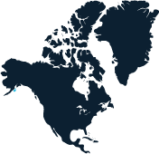
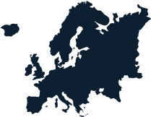
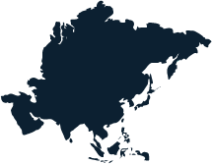
DEUFOL Worldwide
over 60
Years of valuable experience
We develop flexible, intelligent and innovative solutions along your supply chain
We provide you with digital transparency to speed up processes
We offer you a global network with over 90 locations in 13 countries with uniform global standards
Turnover 2022: around € 272 million
Employees: around 2,000
NORTH
AMERICA
EUROPE
ASIA
5 locations
82 locations
2 locations

Slide 4
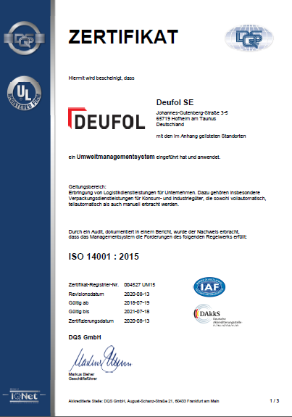
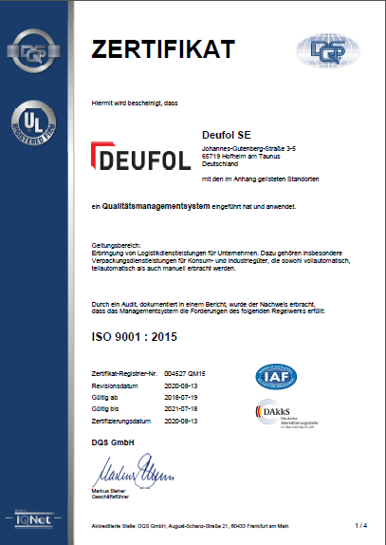
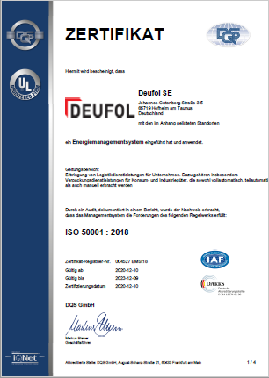
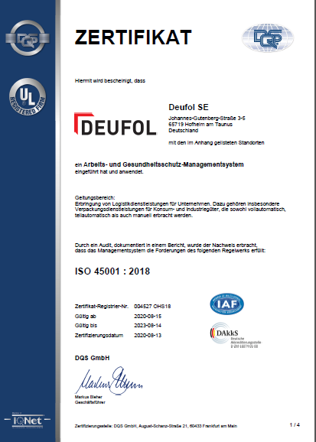
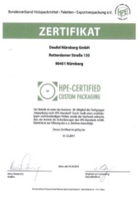
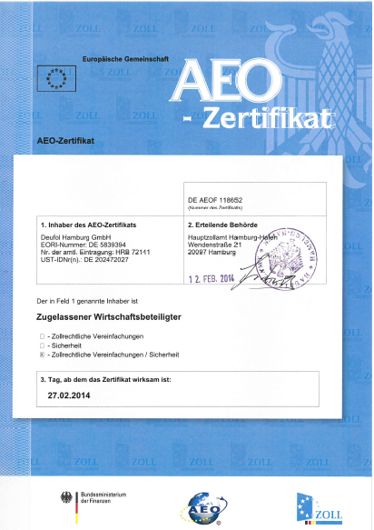
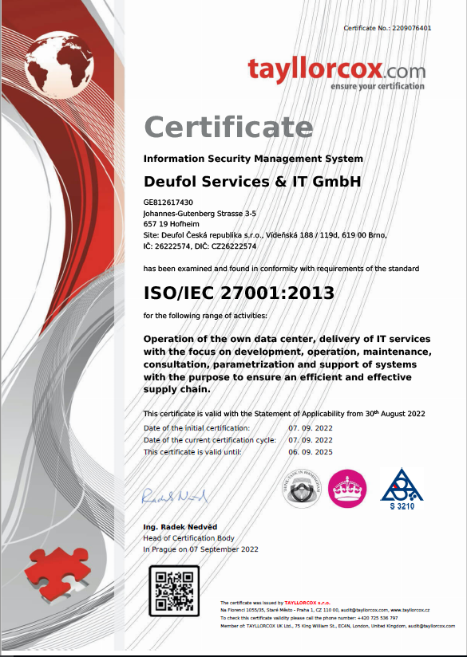
DEUFOL quality.
Member of the HPE trade association
Environmental management ISO 14001 : 2015
Quality management ISO 9001 : 2015
Energy management ISO 50001 : 2018
Occupational health and safety management ISO 45001 : 2018
RegB status at location level
AEO status at company level
AND BRAND NEW FOR THE SECURITY OF YOUR DATA: Certification of our IT services and platform ISO/IEC 27001 : 2013
TESTED AND CERTIFIED.

Slide 5
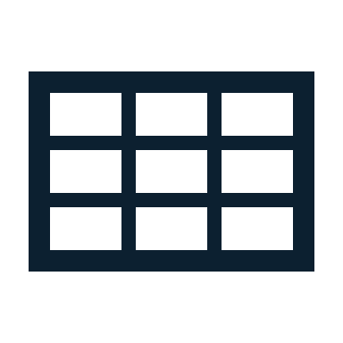
Sustainability @ DEUFOL
First-time materiality analysis in accordance with the ESRS (double materiality) carried out in 2024.
greenhouse gas balance for the German locations. Result: In the 2023 financial year, greenhouse gas emissions were reduced by 18% compared to 2022. Scope 2 emissions were even reduced by 80%. This is due to the switch to renewable energy sources.
Total: 3,773 tCO₂ e (2023) / 4,577 tCO₂ e (2022) - 18%
Scope 1: 2,708 tCO₂ e (2023) / 2,614 tCO₂ e (2022) + 4%
Scope 2: 212 tCO₂ e (2023) / 1,035 tCO₂ e (2022) - 80%
Scope 3*: 853 tCO₂ e (2023) / 928 tCO₂ e (2022) - 8%
First EcoVadis rating carried out in 2024 .^{**)}
⁾ *Category 3: Fuel and energy-related activities (not included in Scope 1 and 2)
**⁾ Result still pending

Slide 6
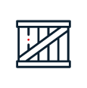
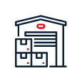
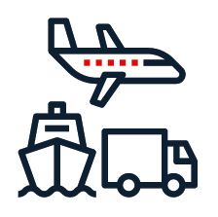
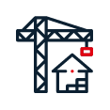
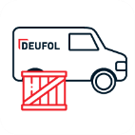
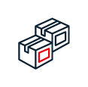
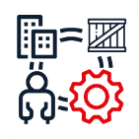
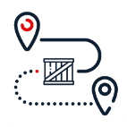
DEUFOL Services
Packaging
Packaging advice
Warehouse management
Transport organisation
Onsite logistics
Mobile packaging
HUB solutions
Industrial service
Dangerous goods service
Supply chain consulting
Photo documentation
Warehouse management systems
Supply Chain Management
Software
Freight monitoring

Slide 7
What are your needs?

Slide 8
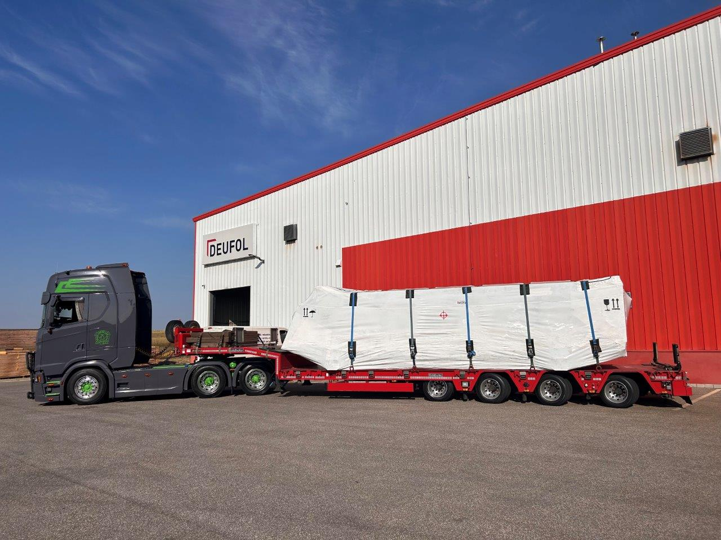
Warehouse Solution in Slowakia
The price of the rent is €/m2/month.
An inflation clause will be part of any long-term contract, taking into account the inflation and its impact on rental prices.
The price includes just rental of the hall area without energy and water, these will be invoiced according to the actual consumption.
Service charge: €/1 m2/month. The price includes electronic monitoring of the building by a security service, property tax, insurance of the building, inspection and regular checks of the equipment of the building, winter maintenance of the premises, summer maintenance of the greenery, maintenance of the parking lot statutory basic fire protection of the Deufol hall – fire extinguishers and hydrants.
Parking of customer's personal vehicles is possible
Outdoor area – rental price €/m2/month
Office in the hall: €/m2
Office in the administrative building: €/m2
Prices are exclusive of VAT and are valid for a contract with a minimum term of 5 years.
Any necessary modifications to the hall for the tenant's activities are subject to the consent of the owner of the hall..

Slide 9
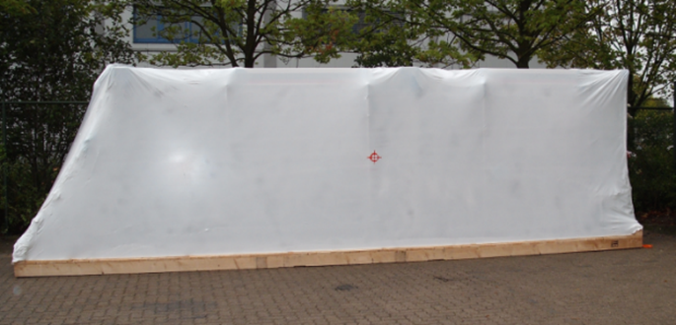
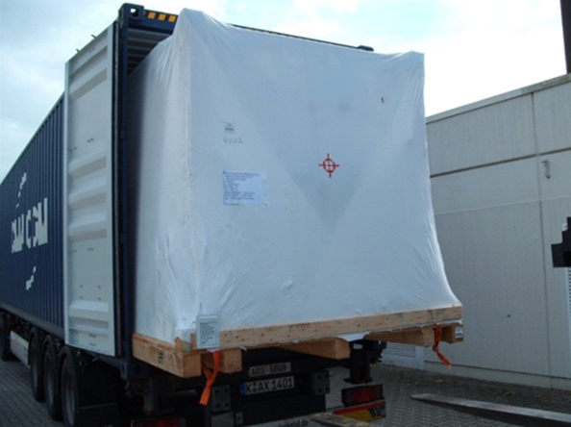
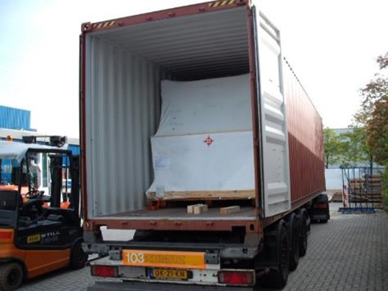
LDPE shrink film
We use impermeable PE shrink hoods to protect products from dirt and the effects of the weather. This film is also available as a VCI variant (preservation).
Material: LDPE shrink film
Material thickness: 200my
Protection from UV radiation
Protection against damage: Transportation / Storage
Protection against dust / dirt
Protection against "water pocket formation"
Protection from rain
Stabilization of the packaging

Slide 10
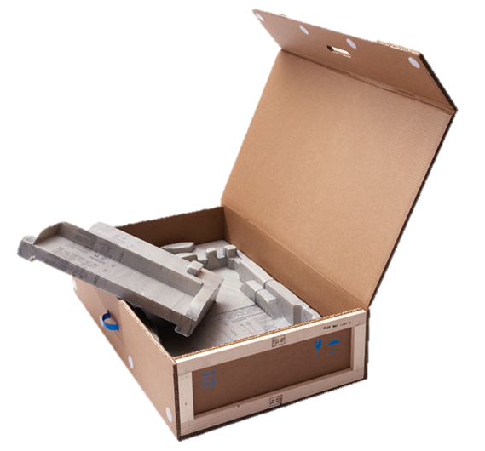
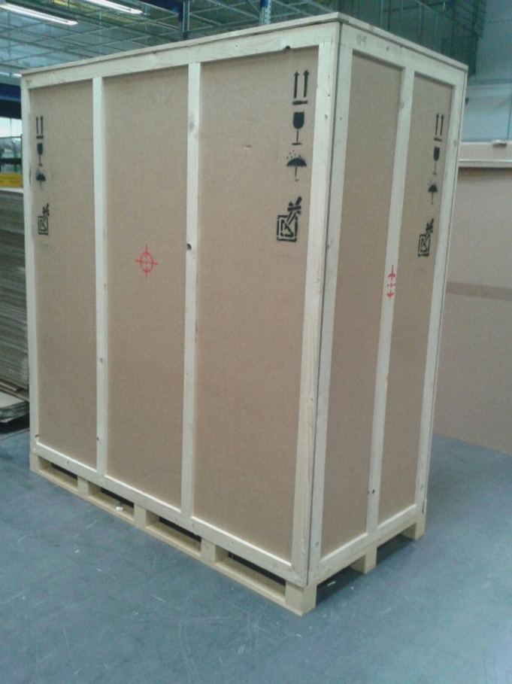
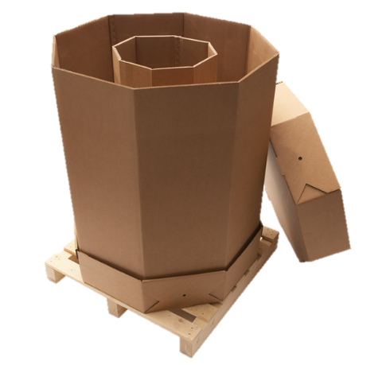
Cardboard packaging solutions
40% weight saving
Transportable
Customizable
Outdoor storage possible

Slide 11
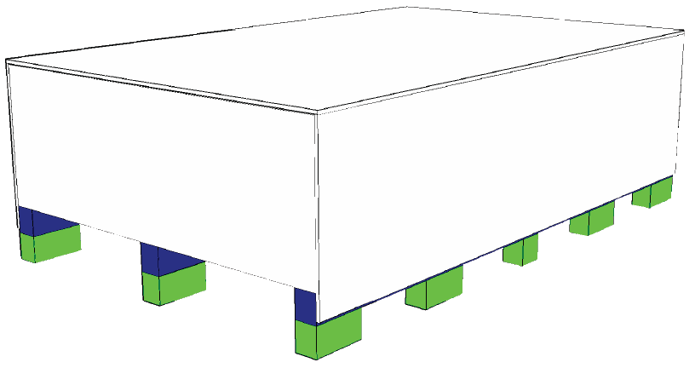
Standardization of the packaging materials used
Load carrier systems for sea container transport
Container boxes
"DS-Box"
Container pallets
"ConPal"
Designed for sea container transport in 20"/ 40" box, HC and OT
Can be combined with each other according to the "Tetris" system
Longitudinal and transverse loading possible
Permissible floor load is 1,000 kg/m² floor area
Handling with forklift and/or pallet truck
Designed for sea container transport in 20'/ 40' box, HC and OT
In combination, this always results in full containers
Positive locking is given
Handling with forklift and/or pallet truck

Slide 12
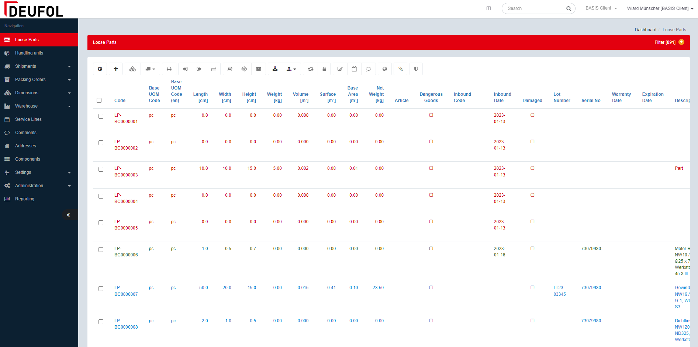
The control station management tool
Overview
Covering the entire value chain
Unlimited hierarchy levels for lot parts & handling Units
Loose parts and handling unit management
Unlimited number of locations, zones and Storage locations
Basic functionalities of a supplier and customer portal
IT Framework
Web-based information system
In function with barcode scanner / scan app
High flexibility for independent customizations / Customization

Slide 13
DEUFOL Global Overview

Slide 14
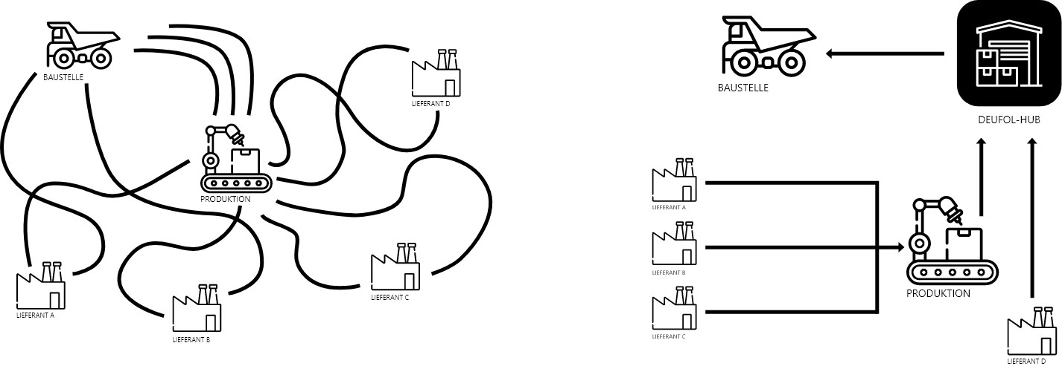
DEUFOL HUB solutions
Your advantage through our network
Deufol locations can be used as a logistics hub. Over 100,000 square metres of hall space with up to 406 to. crane capacity for collecting, packing and stowing your goods.
Bundling and consolidation of your goods flows at the Deufol locations with direct connection to lorry, sea and air freight.
Relieve your resources with our integrated processing of your goods flows.
Reduce your transport costs with our optimisation concepts for logistics, packaging and construction site management.

Slide 15
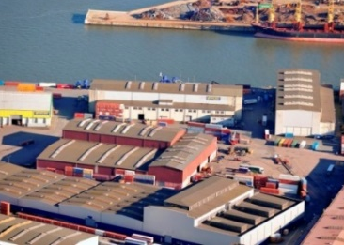
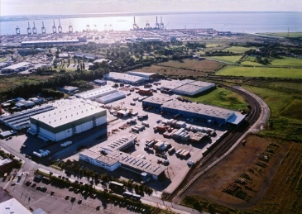
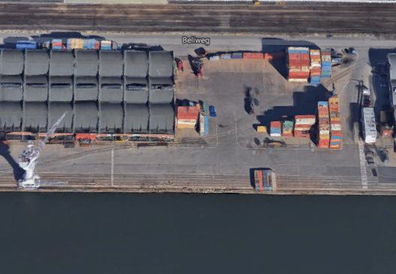
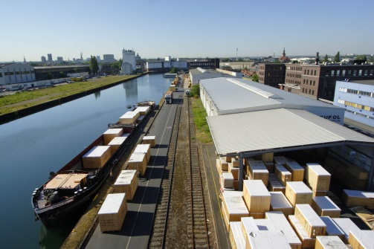
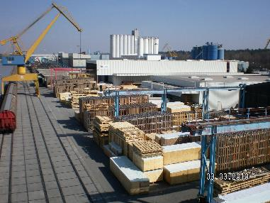
DEUFOL HUB-Lösungen
Hamburg
Bremerhaven
Antwerpen
Ruhrgebiet Dortmund / Mülheim a. d. Ruhr
Nürnberg
IM ÜBERBLICK:
4 Mobilkrane: bis 406 t Reach-Stacker: bis 45 t Stapler/ Hebelast: bis 40 t Brückenkran (Halle): bis 110 t
Mitarbeiter: 150
IM ÜBERBLICK:
Reach-Stacker: bis 45 t Stapler/ Hebelast: bis 23 t Mitarbeiter: 20
IM ÜBERBLICK:
Brückenkran: bis 3 t
Reach-Stacker: bis 45 t
Mitarbeiter: 20 – 40
IM ÜBERBLICK:
Flurkran: bis 50 t
Portalkran: bis 100 t
Mitarbeiter: 230
IM ÜBERBLICK:
Kran: bis 32 t (2x 16 t​)
Galgenkran: bis 1,5 t​
Hebelast: bis 16 t​
Verfügbare Flächen:
Gesamt: 130.000 m²
Außenfläche: 75.000 m² Hallen/Lagerfläche: 55.000 m²
Verfügbare Flächen:
Gesamt: 23.500 m²
Außenfläche: 20.000 m²
Hallen/Lagerfläche: 3.500 m²
Verfügbare Flächen:
Gesamt: 30.000 m² Außenfläche: 12.000 m²
Hallen/Lagerfläche: 18.000 m²
Verfügbare Flächen:
Gesamt: 41.900 m²
Außenfläche: 24.500 m²
Hallenfläche: 17.400 m²
Verfügbare Flächen:
Gesamt: 9.500 m²
Hallen/Lagerfläche: 5.000 m²

Slide 16
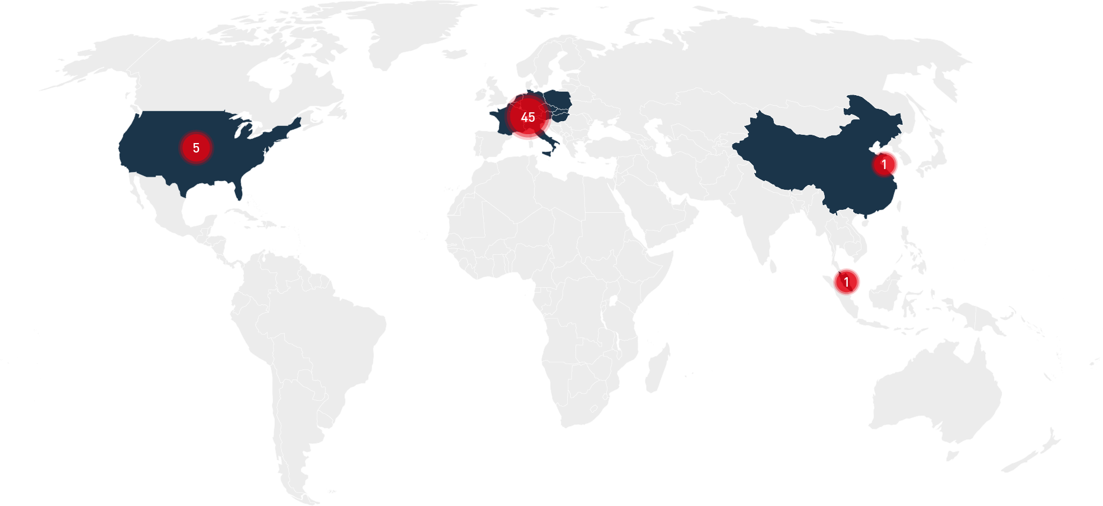
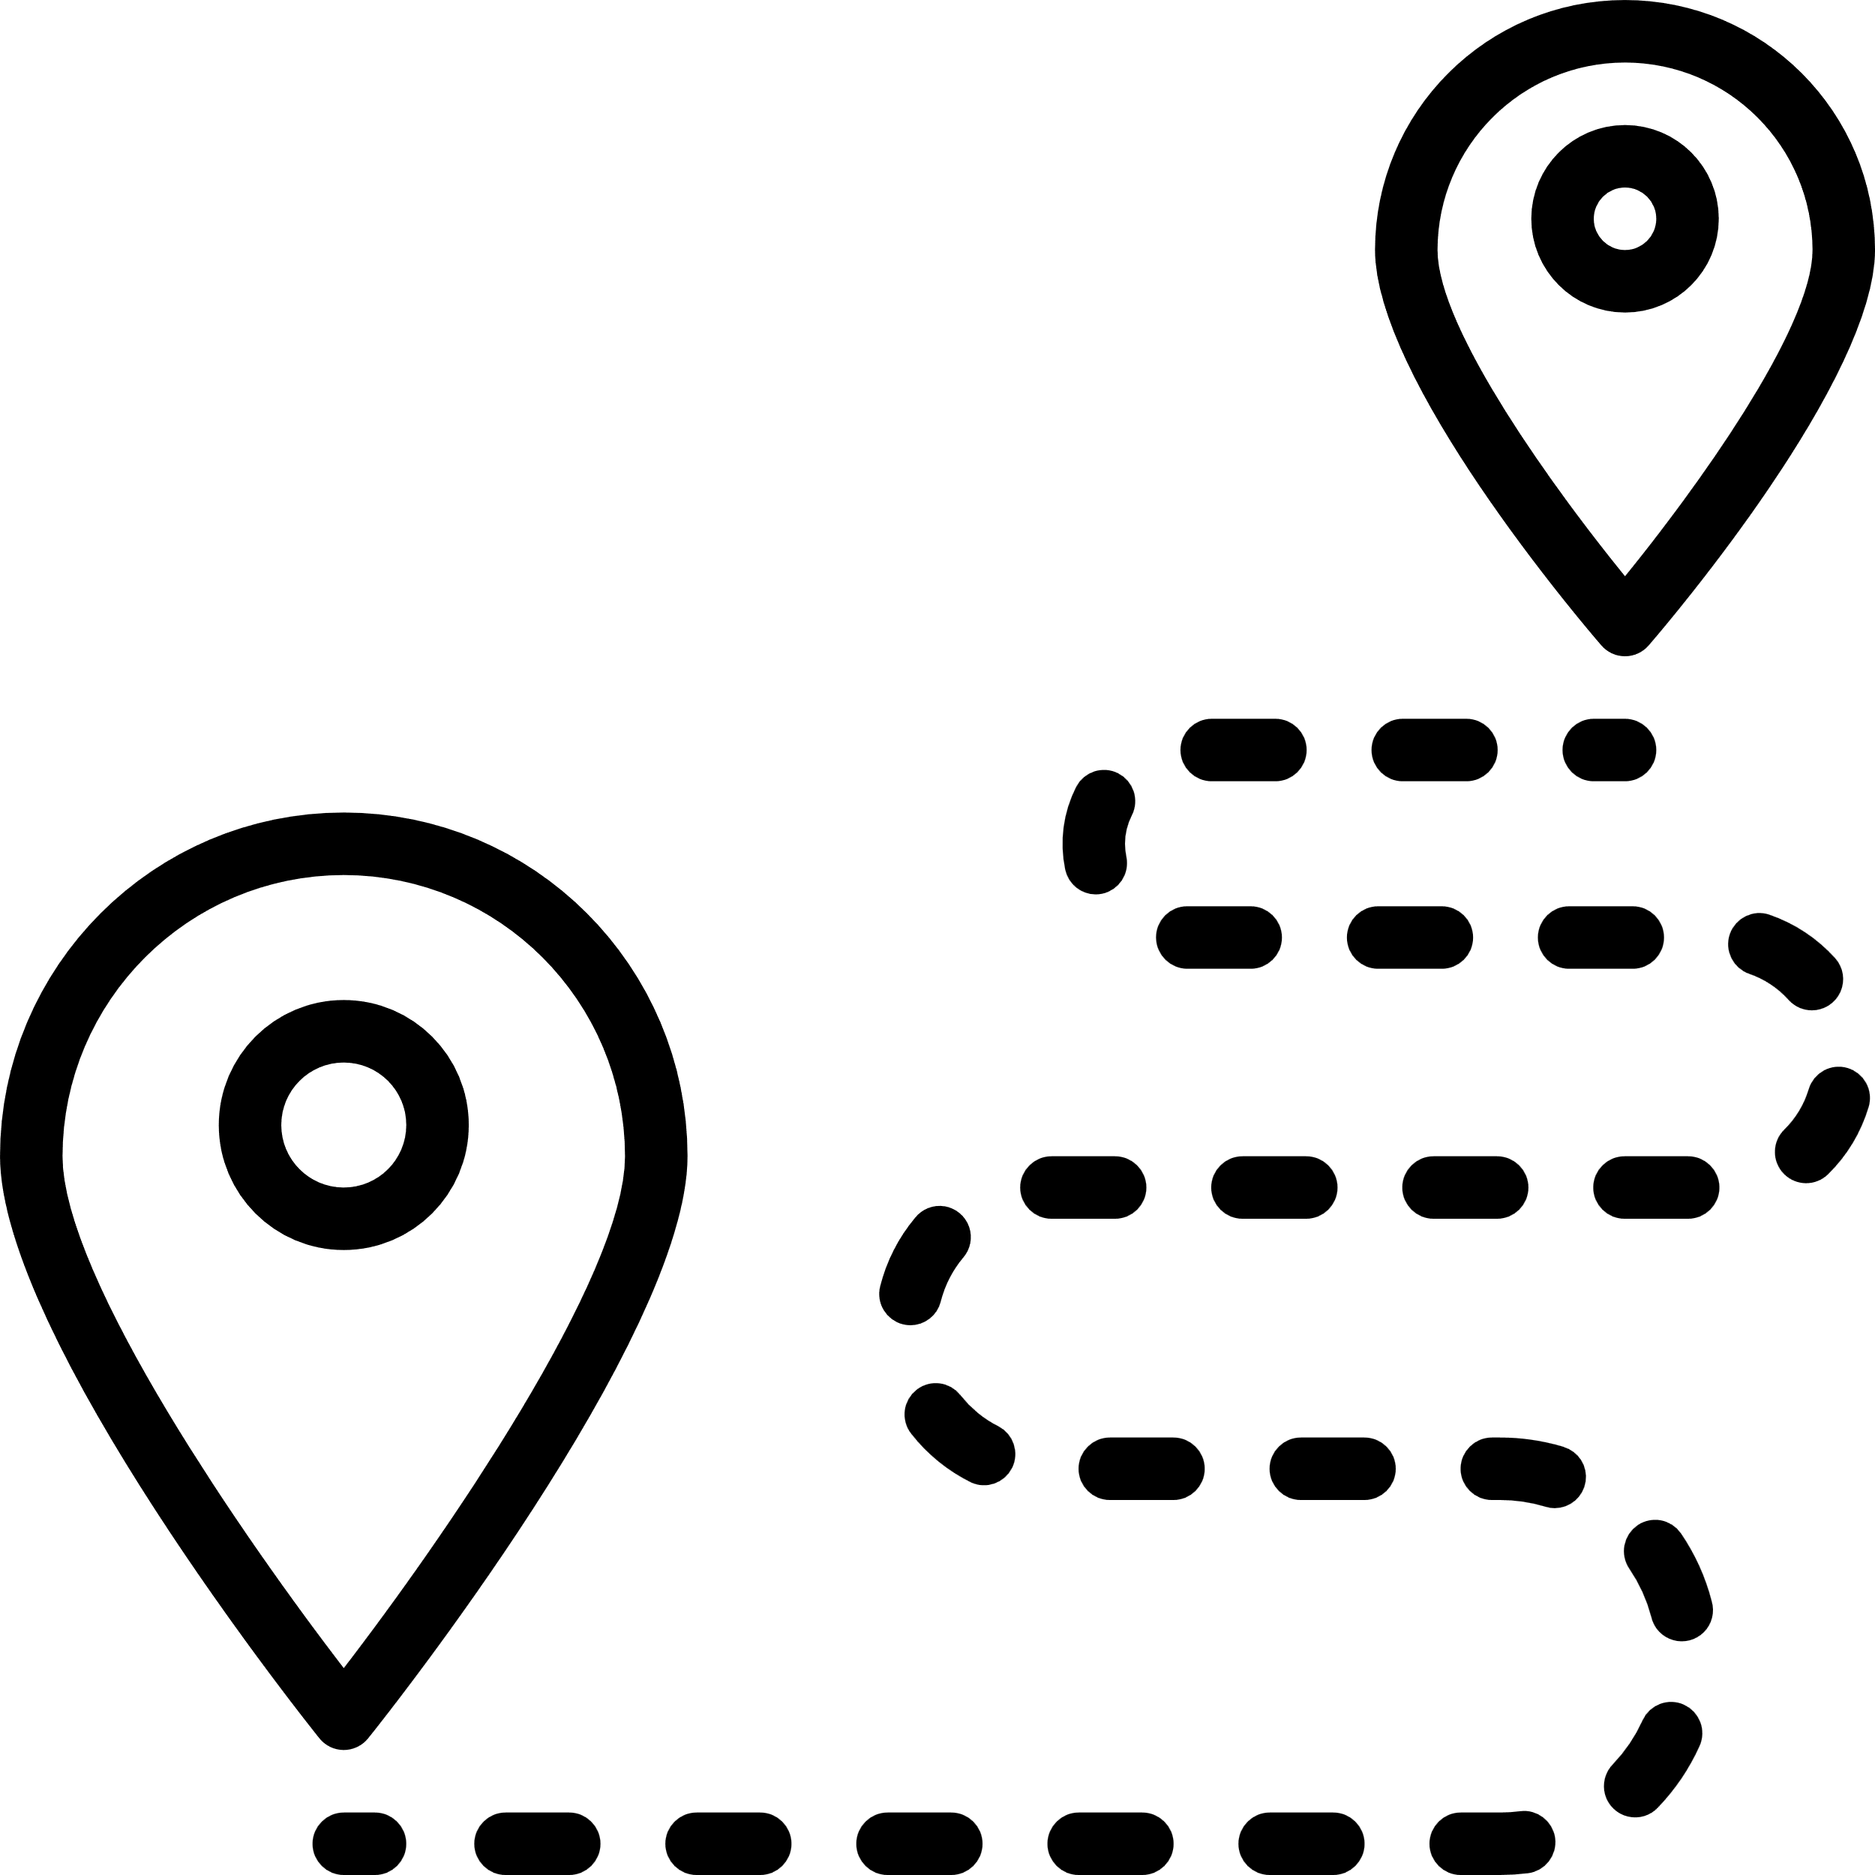
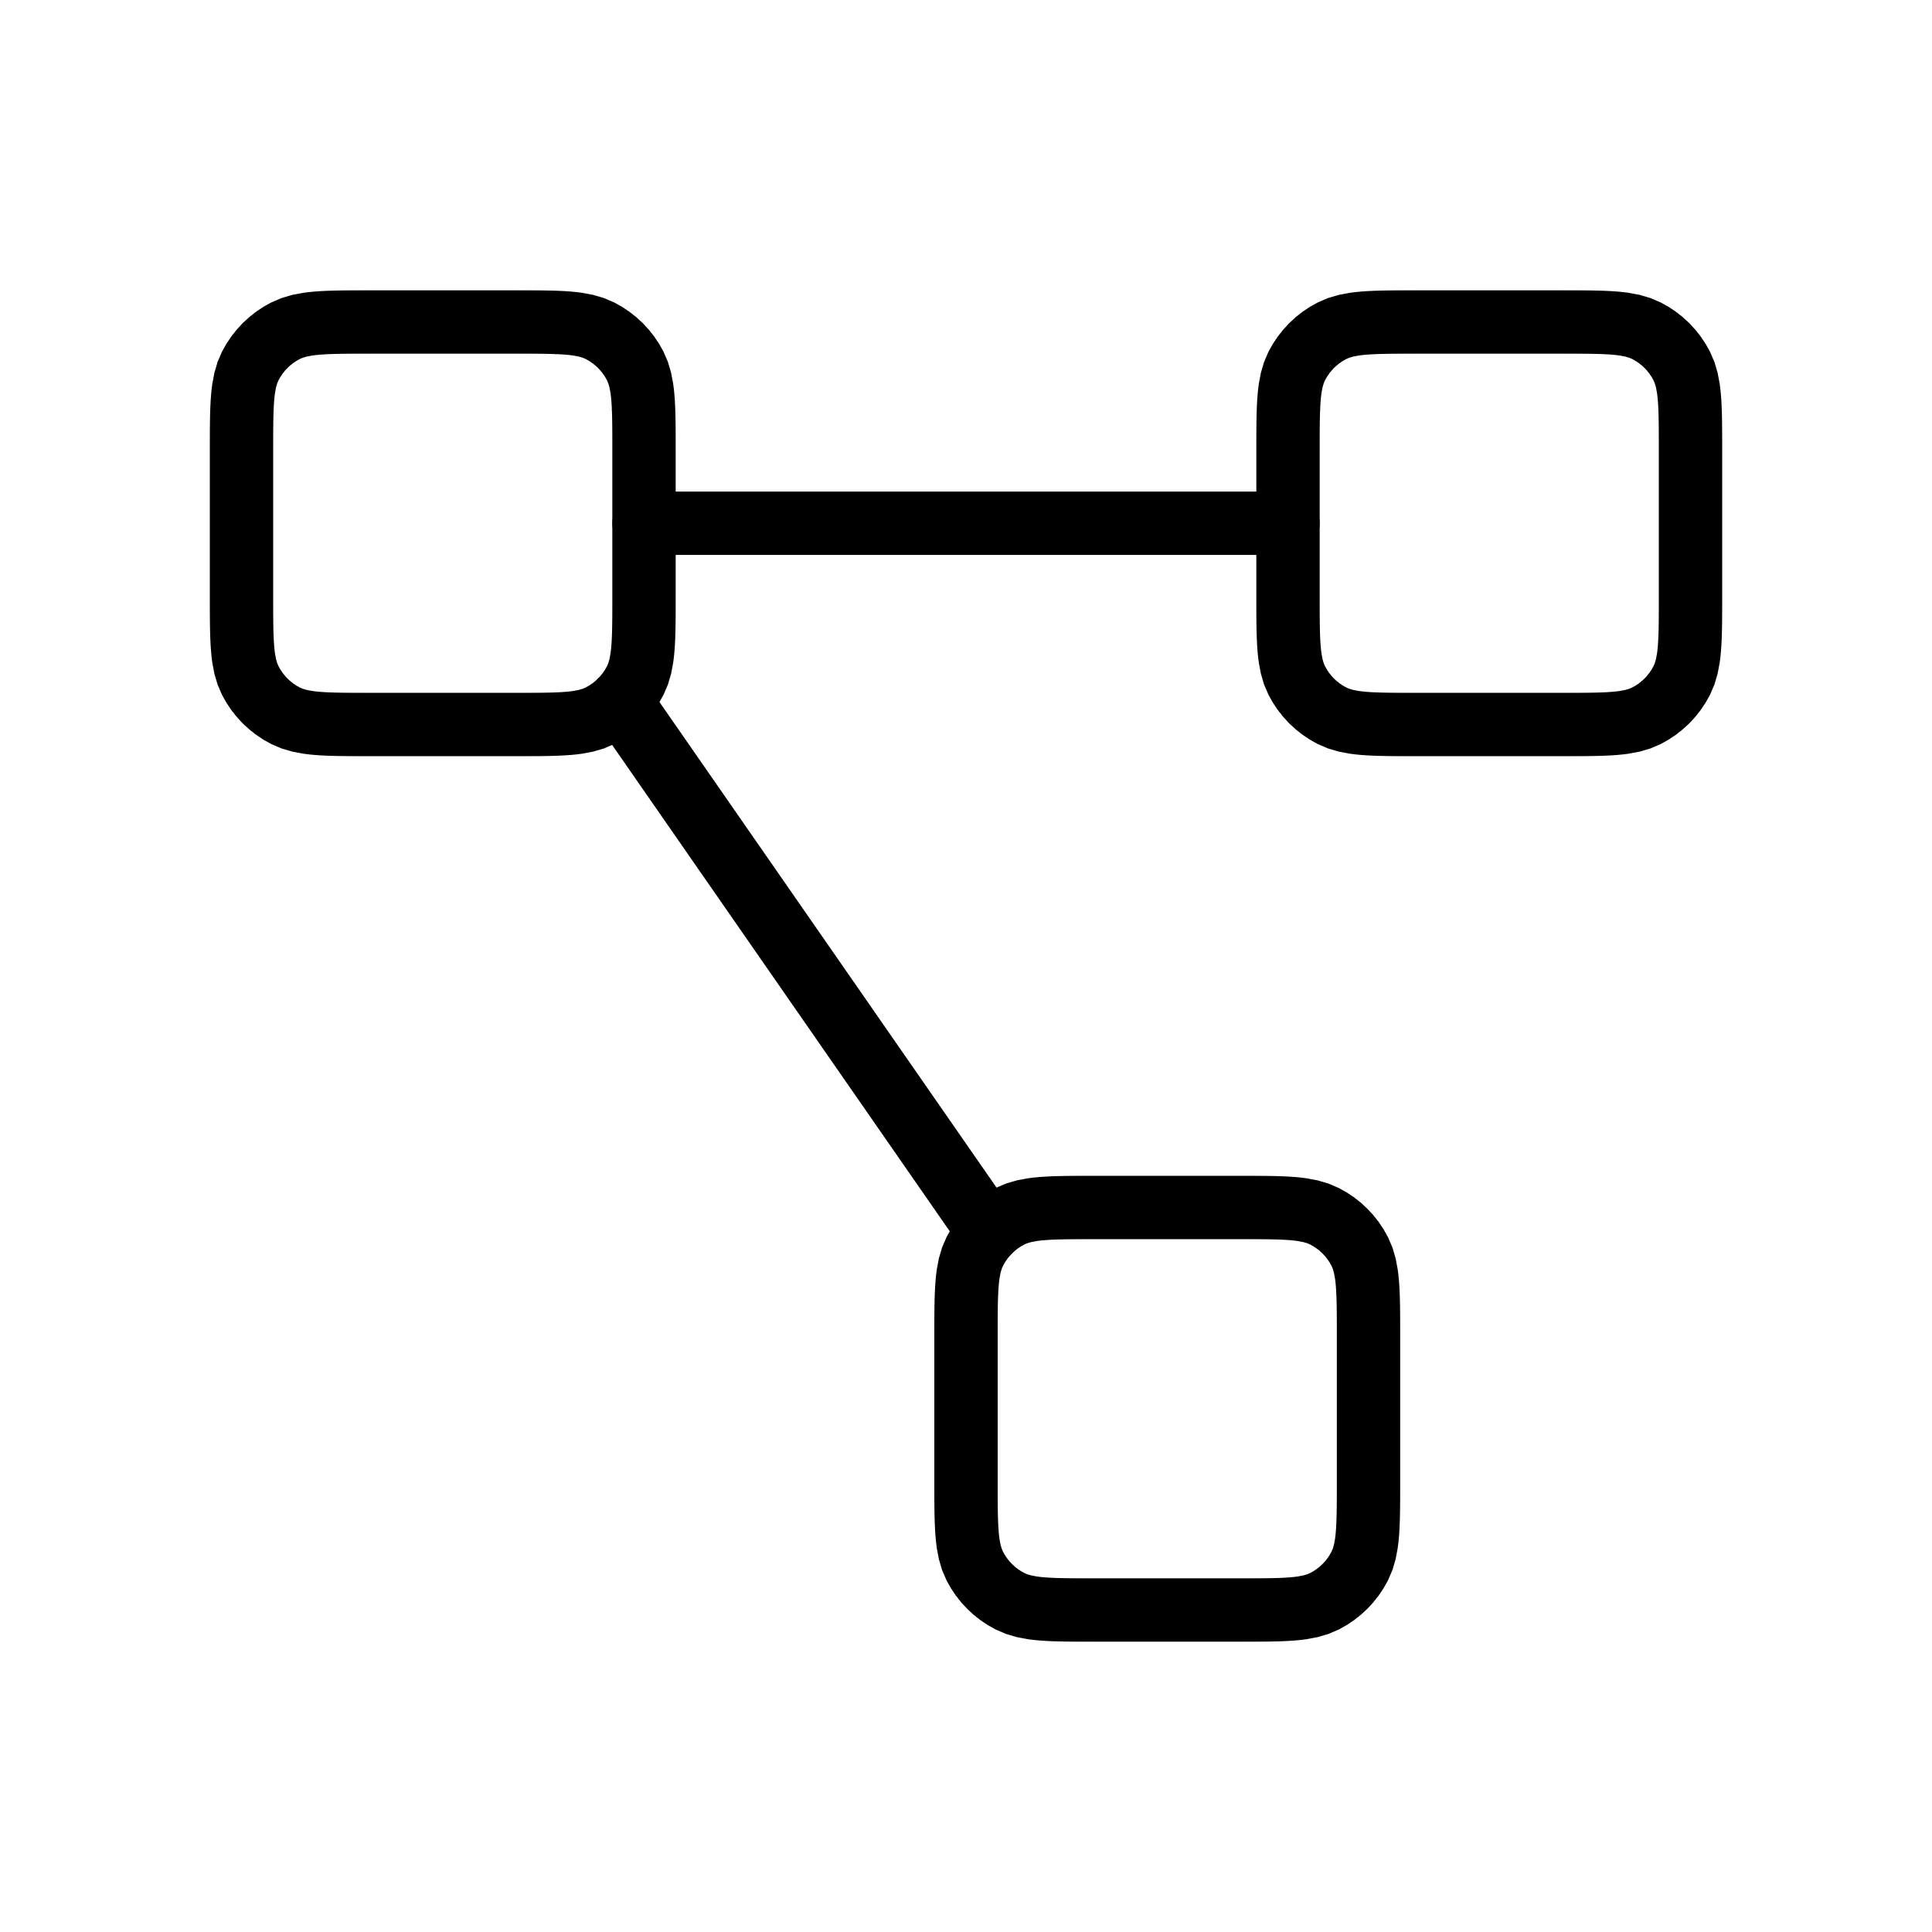
REMOVING LIMITS OUR INTERNATIONAL END-2-END BUSINESS AREAS
Digital solutions
Sustainable products
HUB infrastructure
E2E services
Project Solutions
& Logistics

